Slide 1
ENSE 470, Milestone 2
ByteThis Software
Taylor Petrychyn, Alwin Baby, and Konstantin Kharitonov
January 18th, 2017

Slide 2
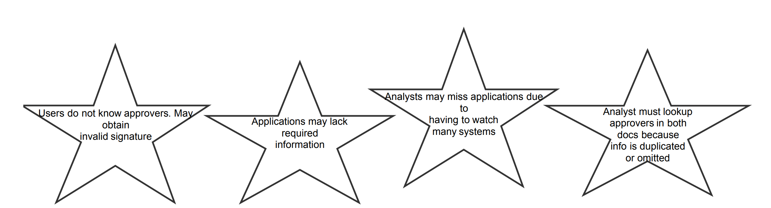
Kaizen Burst from Milestone 1

Slide 3
Ideas!

Slide 4
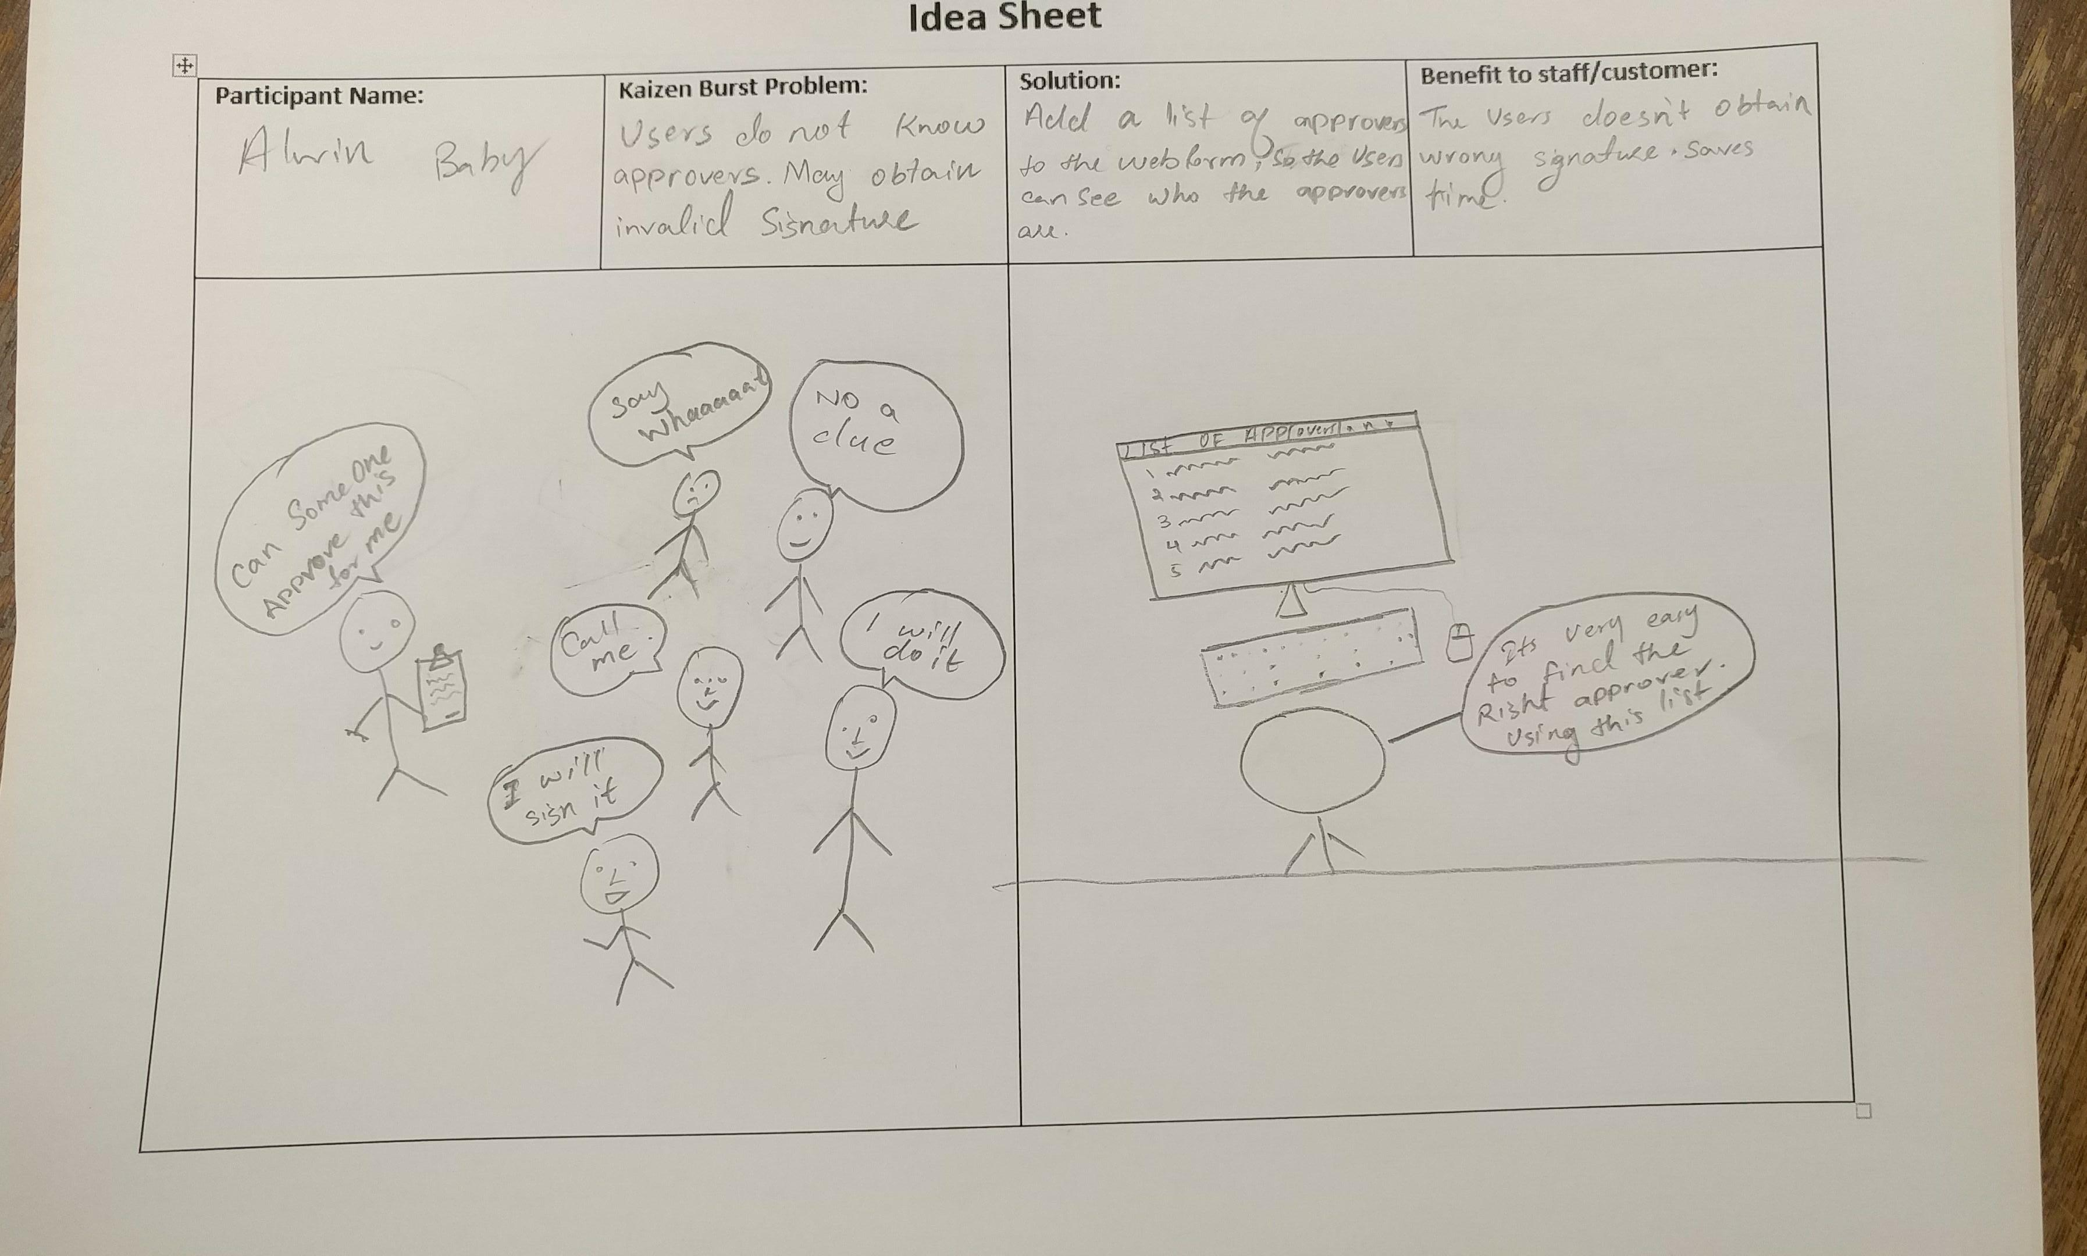

Slide 5
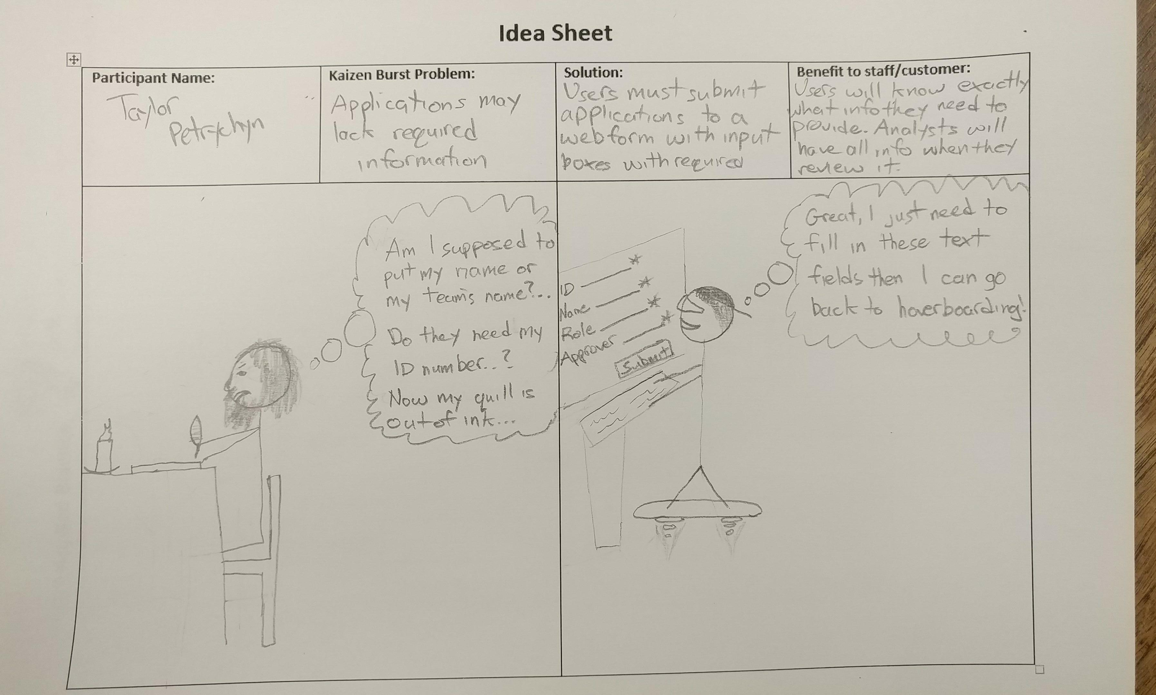

Slide 6
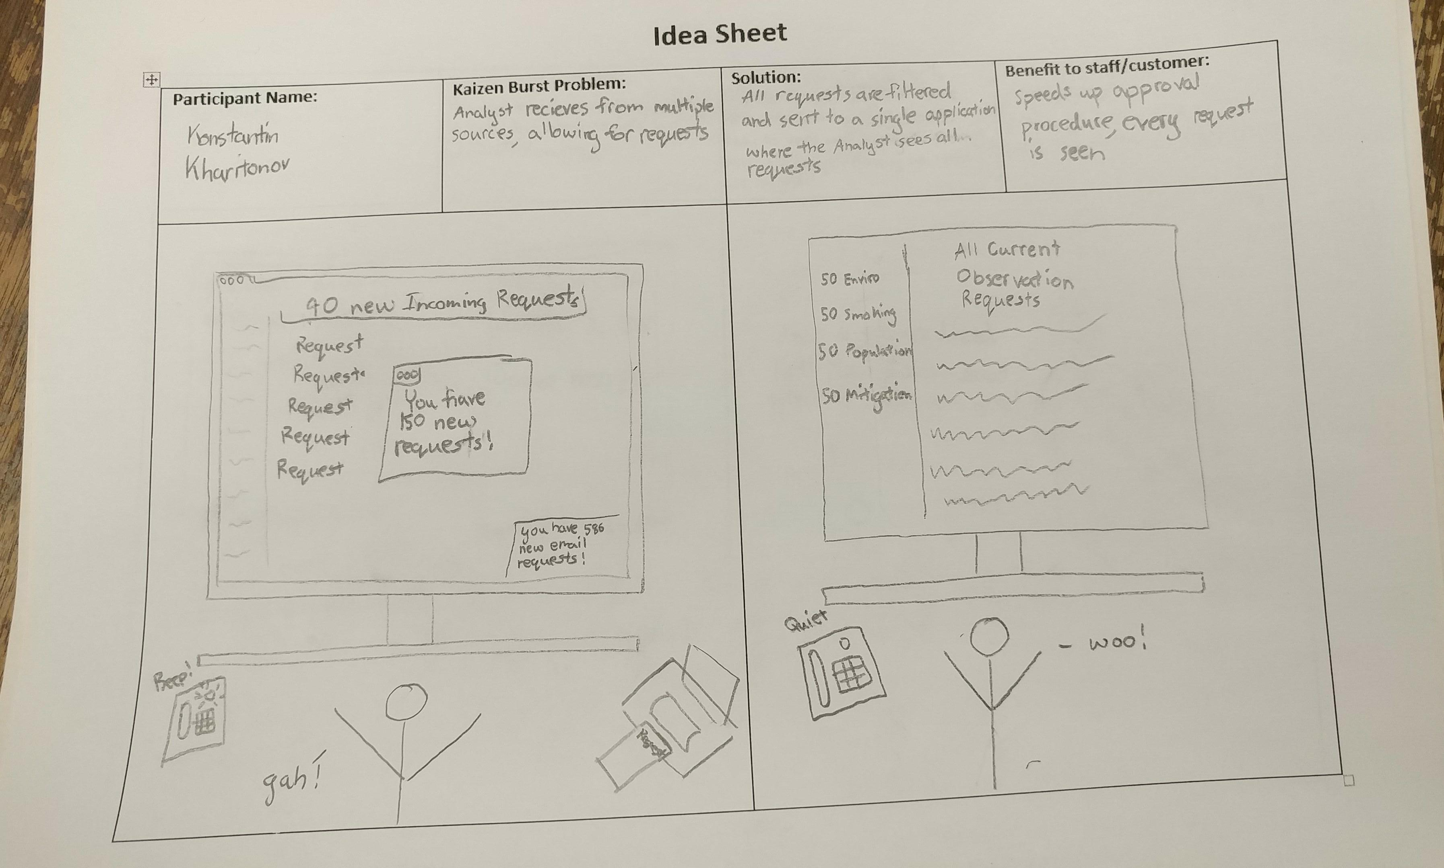

Slide 7
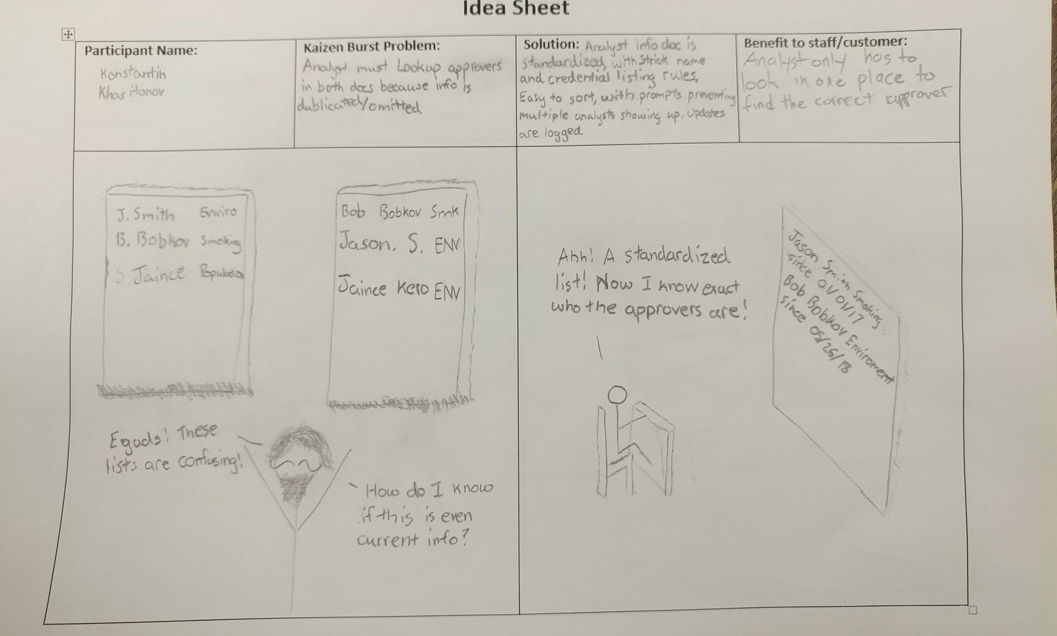

Slide 8
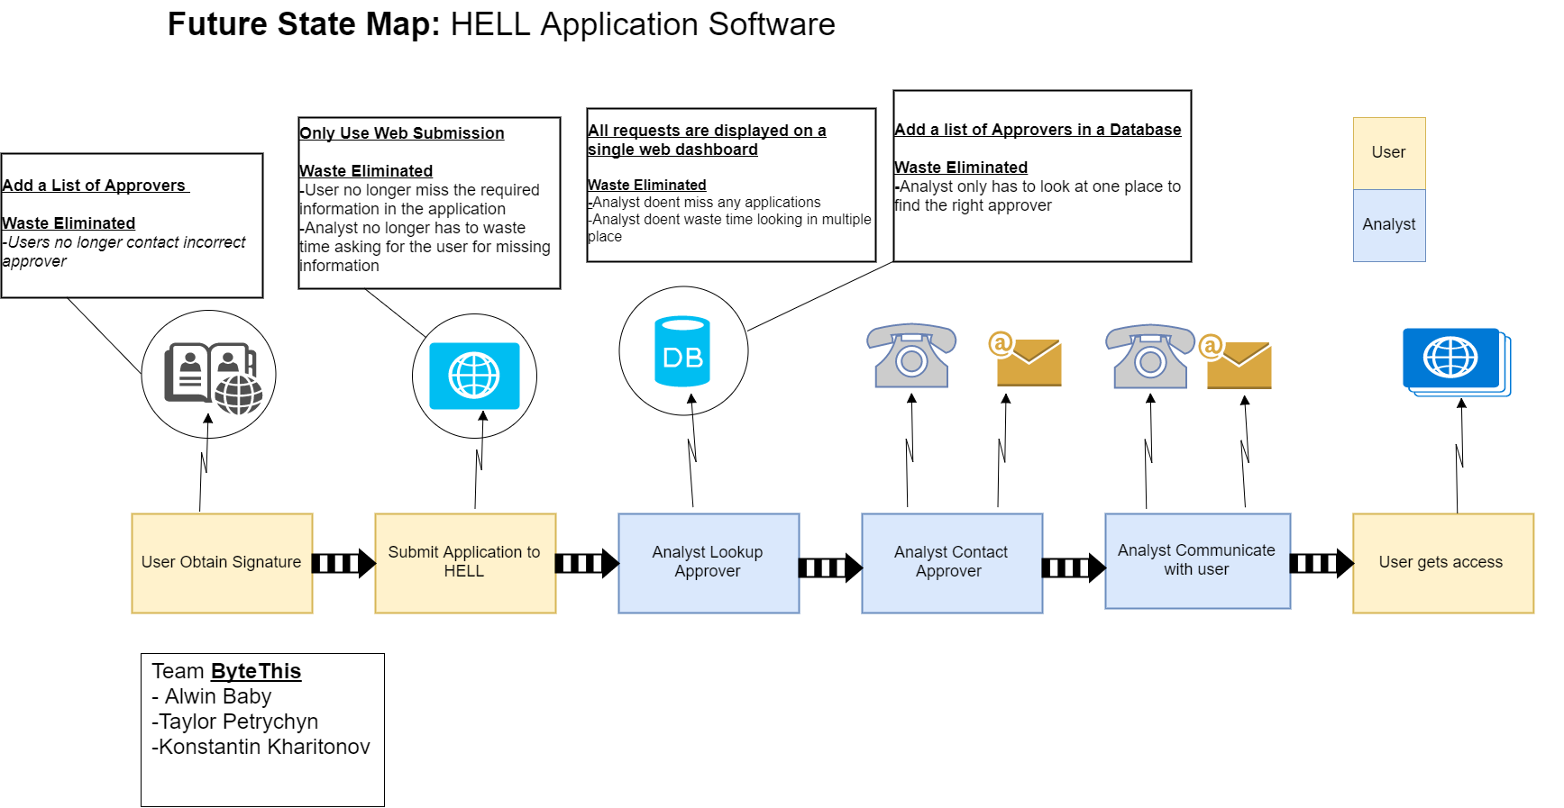

Slide 9
Group reflection
How did you feel about this milestone? What did you like about it? What did you dislike?
  Planning and drawing the Ideas, being creative with them
  Hand drawing does take some patience
What did you learn about yourself as you collaborated and worked through this milestone?
  The importance group discussions, team work
How will you use what you have learned going forward?
  Always have a source to refer back to when coding
What “stuff & things” related to this milestone would you want help with?
  Ability to accurately provide ideas more clearly

